Slide 1
Clean Coding in PL/SQL and SQL
Brendan Furey, April 2019
A Programmer Writes… (Brendan's Blog)
Ireland Oracle User Group, April 4-5, 2019
Notes:
http://aprogrammerwrites.eu/

Slide 2
whoami
Freelance Oracle developer and blogger
Keen interest in programming concepts
Started career as a Fortran programmer at British Gas
Dublin-based Europhile
25 years Oracle experience, currently working in Finance

Slide 3
Agenda
General Programming Design Concepts (8 slides)
Outlining basic concepts behind programming design, and programming paradigms
Design Principles and Program Modules (6 slides)
Noting important design principles, and their application to package and subprogram structure
Object Types and Collections (6 slides)
Showing how object and record types and collections may be used to write cleaner code
API Design with Examples (6 slides)
Explaining how to design APIs for both usability and internal structure, with examples of external design and internal refactoring
Oracle and Other Languages (3 slides)
Concerning the integration of PL/SQL programs with other languages
Oracle's Object Orientation (5 slides)
Discussing appropriate use of Oracle’s object-oriented features
SQL and Modularity (4 slides)
Discussing application of modular design concepts in relation to SQL
Conclusion (2 slides)
Recommendations around Oracle program design

Slide 4
General Programming Design Concepts
General Programming Design Concepts
Outlining basic concepts behind programming design, and programming paradigms

Slide 5
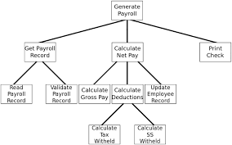
Modularity
Modularity
“The concept of modularity is used primarily to reduce complexity by breaking a system into parts of varying degrees of interdependence and independence and "hide the complexity of each part behind an abstraction and interface.“
Many ways to decompose, but aim for:
High Cohesion within components
Low Coupling between components
Different programming paradigms decompose in different ways…
OCR Computing A-Level Revision
Notes:
https://en.m.wikipedia.org/wiki/Modularity
http://www.ocrcomputing.org.uk/f452/solution_design/modular.html

Slide 6
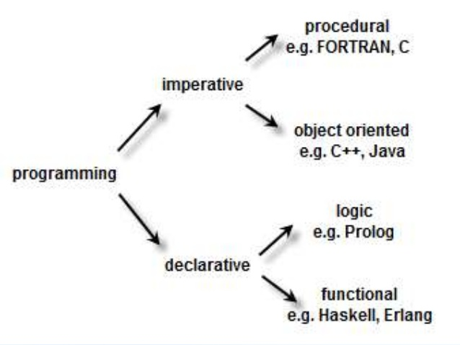
Programming Paradigms: Diagram
Overview of programming paradigms
Notes:
https://www.slideshare.net/davilinjohnson/overview-of-programming-paradigms

Slide 7
Imperative and Declarative Approaches
Two main approaches to programming
Imperative programming
Focuses on how to execute, defines control flow as statements that change a program state
Declarative programming
Focuses on what to execute, defines program logic, but not detailed control flow
SQL and PL/SQL
SQL is a declarative programming language based on mathematical set theory
Database-centred, Structured Query Language
Not regarded as a functional programming language, but closer than to other paradigms
PL/SQL is an imperative, block-structured programming language based on ADA
Core language procedural, but…
Embedded SQL
Object-oriented features from v8 (1997); object types widely used, OO features such as inheritance and type bodies hardly ever used (why? to be discussed)
How do we most effectively use the two languages together?...
Notes:
https://en.wikipedia.org/wiki/Comparison_of_programming_paradigms

Slide 8
Prefer Declarative to Imperative
Declarative programming reduces the amount of code developer writes
Use of local variables, iteration etc. removed, detailed logic handled internally by language
Reduces scope for bugs, and enables faster development
SQL Query
Returns data set from database tables based on declarative logic…
Specified table joins
Transformation rules, including aggregation, analytics etc.
…with some procedural features also possible, such as:
Subquery factor sequencing and recursion
Query projection originally flat, now may use object-relational mappings to return hierarchical data sets
SQL and Modularity
Complex SQL may need to be designed with modularity in mind, to be discussed later

Slide 9
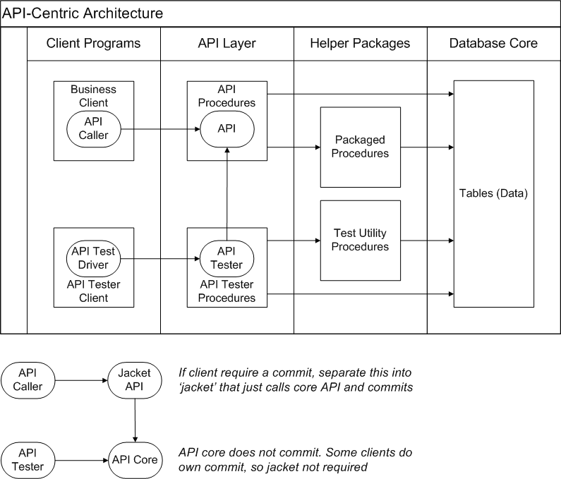
Thick Database Paradigm - Diagram

Slide 10
SQL and PL/SQL Packages
Prefer SQL to PL/SQL
Database APIs form a layer between external or internal clients and the database
The API procedure is ideally just a simple wrapper around (for example):
An SQL query (‘getter’ method for report or web service)
SQL Inserts/Updates/Deletes (IUD) (‘setter’ method for batch program or web service)
More Complex PL/SQL
Setter methods that involve multiple table IUDs
Unit test programs that require test data setup and teardown for repeatability
Instrumentation such as code timing and information and error logging
PL/SQL and Modularity
Consider how best to write more complex PL/SQL in a clean, modular way
Take note of advantages various programming paradigms may have…

Slide 11
Programming Paradigms: Definitions
Main programming paradigms / Overview of the four main programming paradigms
[Definitions below come from the two links above]
Procedural programming
Specifies the steps a program must take to reach a desired state
First do this and next do that
Object-oriented programming
Organizes programs as objects: data structures consisting of datafields and methods together with their interactions
Send messages between objects to simulate the temporal evolution of a set of real world phenomena
Functional programming
Treats programs as evaluating mathematical functions and avoids state and mutable data
Evaluate an expression and use the resulting value for something
Logic programming – from second link only
Answer a question via search for a solution
Seems less natural in the more general areas of computation
Notes:
https://en.wikipedia.org/wiki/Comparison_of_programming_paradigms
http://people.cs.aau.dk/~normark/prog3-03/html/notes/paradigms_themes-paradigm-overview-section.html

Slide 12
Design Principles and Program Modules
Design Principles and Program Modules
Noting important design principles, and their application to package and subprogram structure

Slide 13
General Design Principles
DRY: Don't repeat yourself
“Every piece of knowledge must have a single, unambiguous, authoritative representation within a system“…They (Andy Hunt and Dave Thomas) apply it quite broadly to include "database schemas, test plans, the build system, even documentation“
WET = "write everything twice", "we enjoy typing" ☺
Obvious case in re-usable functions in programming languages
Relational databases apply DRY to data by normalization
Use of object types and records can push DRY to field level (to be discussed)
Coupling versus cohesion
“Coupling refers to the interdependencies between modules, while cohesion describes how related the functions within a single module are"
Aim for low coupling and high cohesion, which can be facilitated by…
Functional design
“A functional design assures that each modular part of a device has only one responsibility and performs that responsibility with the minimum of side effects on other parts"
How can we apply this in PL/SQL packages? (to be discussed)
Notes:
https://en.wikipedia.org/wiki/Don%27t_repeat_yourself
https://en.wikipedia.org/wiki/Coupling_(computer_programming)#Coupling_versus_cohesion
https://en.wikipedia.org/wiki/Functional_design

Slide 14
Information Hiding and Subprogram Nesting
information hiding
“In programming, the process of hiding details of an object or function. Information hiding is a powerful programming technique because it reduces complexity. ... In a sense, the entire hierarchy of programming languages, from machine languages to high-level languages, can be seen as a form of information hiding.
Information hiding is also used to prevent programmers from intentionally or unintentionally changing parts of a program” - Vangie Beal in Webopeida
Nesting in Ada Programs is for the Birds (Clarke, Wileden & Wolf, 1980)
“…a tree structure is seldom a natural representation of a program…
We have proposed a style for programming in Ada that precludes the use of nesting and thereby avoids nesting's negative impact on program organization and readability.“
PL/SQL based on Ada and has similar package structure, and nesting capabilities
Nesting blocks or subprograms makes information from higher levels accessible
Reduction in information hiding tends to increase complexity
Suggests that nesting subprograms and blocks should be exceptional
Notes:
https://www.webopedia.com/TERM/I/information_hiding.html
http://www.doc.ic.ac.uk/~alw/doc/papers/ada80.pdf

Slide 15
Inheritance Hierarchies
On Inheritance (in Goodbye, Object Oriented Programming (Scalfani, 2016)
“If you look at the real world, you’ll see Containment (or Exclusive Ownership) Hierarchies everywhere.
What you won’t find is Categorical Hierarchies"
JavaScript Inheritance vs Composition (Tyler McGinnis, 2019)
One of many articles arguing against use of inheritance in OO languages
Oracle and object type inheritance
Oracle has had object type inheritance capabilities since around 1997
Very rarely used, and, perhaps, with good reason
We will look at appropriate use of OO concepts and/or syntax in Oracle later…
Notes:
https://medium.com/@cscalfani/goodbye-object-oriented-programming-a59cda4c0e53
https://tylermcginnis.com/javascript-inheritance-vs-composition/

Slide 16
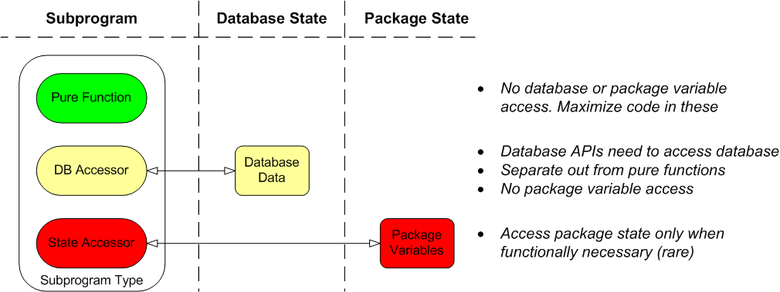
Subprogram Design
Subprogram Design Guidelines
Separate out different subprogram types, maximize the use of pure functions
Avoid state accessors unless functionally required (eg code timing instrumentation)
Use input parameters and a maximum of one return value
Use record and object types to group inputs and outputs
Subprogram structure generally flat, i.e. not nested

Slide 17
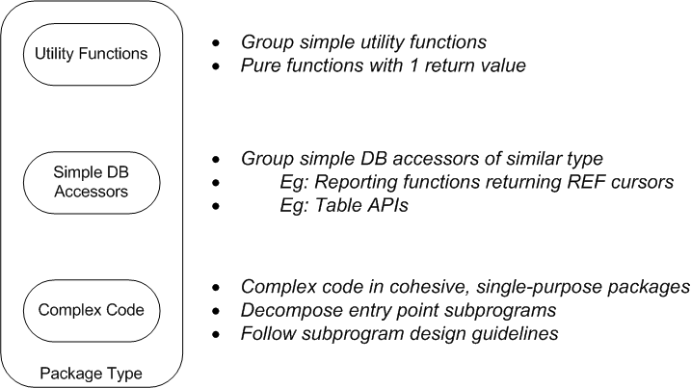
Package Design
API layer in PL/SQL consists of entry-point programs that interface between external clients and the database
Generally access no package state but global constants may be shared
Subprograms small, single purpose, and have 0 or 1 return value
Limit package sizes

Slide 18
Object and Record Types and Collections
Object and Record Types and Collections
Showing how object and record types and collections may be used to write cleaner code

Slide 19
Record and Object Types
Allow grouping of fields and passing as one value: DRY at field level
Fields can be defined with defaults
Fields can be scalars, record/object types or collections
Record Types
PL/SQL-only constructs, and may include PL/SQL associative (index-by) arrays
No default constructor function, but can write our own
No ‘rec IS NULL’ feature, but can add a flag null_yn and use "rec.null_yn = 'Y'"
Object Types
Database level, may not include index-by arrays, can be used for table columns
Have default constructor, and IS NULL works
Suggested Usage of Records vs Objects
Objects necessary where type for database column, or casting in SQL
Lack of index-by array support is a serious limitation for programming
For purely PL/SQL use, record types more flexible, and can be of smaller scope

Slide 20
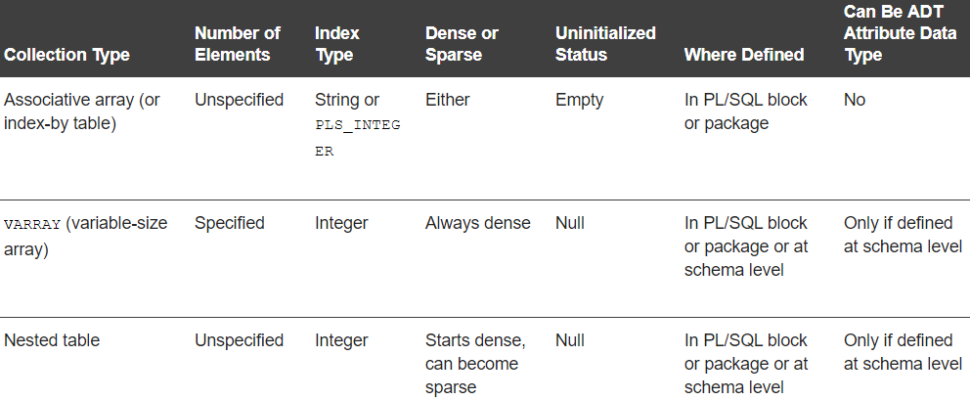
Oracle Collection Types
Collection Types (Oracle Database PL/SQL Language Reference, v12.1)
Notes:
https://docs.oracle.com/database/121/LNPLS/composites.htm#LNPLS00501

Slide 21
Arrays and Functional Programming Methods
FP features allow functions to be passed as parameters to other functions
Cleaner code can result, for example, by removing the need for explicit iteration
Map, Filter, Reduce Methods
Map: Create a new collection by applying a function to each item of the source collection
Filter: Create a new collection by applying a Boolean function to each item of the source collection, returning True if item to be retained
Reduce: Aggregate a collection by applying a function to each item of the source collection, with an accumulator also passed
Can we benefit from these ideas in Oracle?
These methods correspond roughly to SQL concepts (with Select as the iterator):
Map -> Projection (Select expressions based on the fields)
Filter -> Where clause
Reduce -> Aggregate functions with grouping
Use SQL where possible, and then…
Consider design patterns and generic array types to facilitate cleaner PL/SQL code…

Slide 22
Decomposition by Arrays
Processing arrays of independent elements
PL/SQL does not have an FP-style generic map function
However, we may want to apply the same processing to each element in an array
Example 1: A logging method needs to log a list of string values
Example 2: A unit test program needs to test a set of independent scenarios
Design pattern
Encapsulate record processing in a subprogram with a parameter of element type
Call the subprogram within a loop
Subprogram is simpler for processing scalar rather than list (or array of 1-smaller dimension)
PROCEDURE Put_List(
p_line_lis L1_chr_arr,
p_log_id PLS_INTEGER := NULL,
p_line_rec line_rec := LINE_DEF) IS
…
BEGIN
…
FOR i IN 1..p_line_lis.COUNT LOOP
Put_Line(p_line_text => p_line_lis(i),
p_log_id => l_log_id,
p_line_rec => l_line_rec);
END LOOP;
…
Log_Set (My Oracle logging framework on GitHub)
PROCEDURE Put_Line(
p_line_text VARCHAR2,
p_log_id PLS_INTEGER := NULL,
p_line_rec line_rec := LINE_DEF) IS
…
Array type L1_chr_arr in caller
Scalar VARCHAR2 in called subprogram
Notes:
https://github.com/BrenPatF/log_set_oracle

Slide 23
Generic Array Types and Methods
String methods: Join and Split
Most languages have string methods for conversion between list of strings and delimited string
These often simplify programming tasks
PL/SQL Equivalents
Generic list types of string and integer type can be defined at schema level for general use
Higher dimension lists can be defined on top of these, and may be useful, eg in unit testing
CREATE TYPE L1_chr_arr IS VARRAY(32767) OF VARCHAR2(4000);
CREATE TYPE L2_chr_arr IS VARRAY(32767) OF L1_chr_arr;
CREATE TYPE L3_chr_arr IS VARRAY(32767) OF L2_chr_arr;
Generic type declarations
FUNCTION List_Delim (p_field_lis L1_chr_arr,
p_delim VARCHAR2
DEFAULT g_list_delimiter)
RETURN VARCHAR2;
Return a delimited string for input list of strings
FUNCTION Csv_To_Lis(p_csv VARCHAR2
RETURN L1_chr_arr;
Return a list of strings for input delimited string
SELECT Utils.List_Delim(col_1, col_2)
BULK COLLECT INTO l_lis
FROM some_table;
Can select record set with any column list (of char, number, date type) into a generic array

Slide 24
API Design with Examples
API Design with Examples
Explaining how to design APIs for both usability and internal structure, with examples of external design and internal refactoring

Slide 25
Clean API Design: Overloading, Record Types, Defaults
Design Considerations
Aim to make API usage as simple as possible, at least where multiple clients involved
Prefer complexity in centralized APIs to complexity in multiple clients
Subprogram Overloading
Create multiple versions where different types of call required, rather than bundle all options into one
Overloaded subprograms, or just different versions, as applicable
Core logic centralized, called by external subprograms
Record Types
Use to simplify parameters and centralize defaulting
Use to group parameters logically
Defaults
Use defaults wherever possible to allow omission of parameters
Declare default record for record types for use in parameters
Default record has its own field level defaults

Slide 26
API Design: Log_Set Example
TYPE construct_rec IS RECORD(
null_yn VARCHAR2(1) := 'N',
config_key VARCHAR2(30),
header log_headers%ROWTYPE,
do_close BOOLEAN := FALSE);
CONSTRUCT_DEF construct_rec;
Record defined with null flag default ‘N’
2 other scalar fields
Nested record type based on table
Record variable CONSTRUCT_DEF
FUNCTION Con_Construct_Rec(
p_config_key VARCHAR2 := NULL,
p_description VARCHAR2 := NULL,
p_put_lev_min PLS_INTEGER := NULL,
p_do_close BOOLEAN := NULL)
RETURN construct_rec;
Constructor function for record
All parameters optional
Three overloaded functions
Multiple call structures
First form has 2 calls, with/without parameter
FUNCTION Construct(
p_construct_rec construct_rec := CONSTRUCT_DEF)
RETURN PLS_INTEGER;
FUNCTION Construct(
p_line_text VARCHAR2,
p_construct_rec construct_rec := CONSTRUCT_DEF,
p_line_rec line_rec := LINE_DEF)
RETURN PLS_INTEGER;
FUNCTION Construct(
p_line_lis L1_chr_arr,
p_construct_rec construct_rec := CONSTRUCT_DEF,
p_line_rec line_rec := LINE_DEF)
RETURN PLS_INTEGER;
l_rec := Log_Set.Construct;
l_rec := Log_Set.Construct(
p_construct_rec => p_con_rec);
Others have 1 mandatory parameter, with 4 (= 2x2) options for other 2
Client caller can choose best for it…

Slide 27
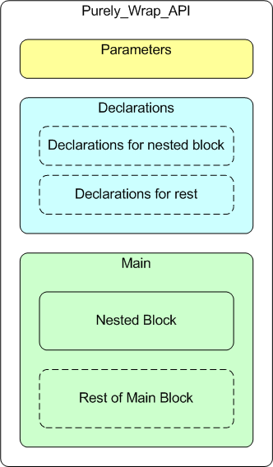
Refactoring Example - Purely_Wrap_API - Before
Unit test subprogram to test a single scenario
Input is test data for the scenario
Formatted as a generic 3-level array, plus 2 offsets
Output is the set of outputs generated from unit under test (uut)
Formatted as a generic 2-level array
Nested block loops over a sequence of events involving calls to logging methods from uut
It has an exception handler, which gets exception details as an output group
Rest of main block gets the other output groups from functions that read the database
Also rolls back and deletes committed data
Split Purely_Wrap_API in two, separating out the nested block
Make call to new function Do_Event_List

Slide 28
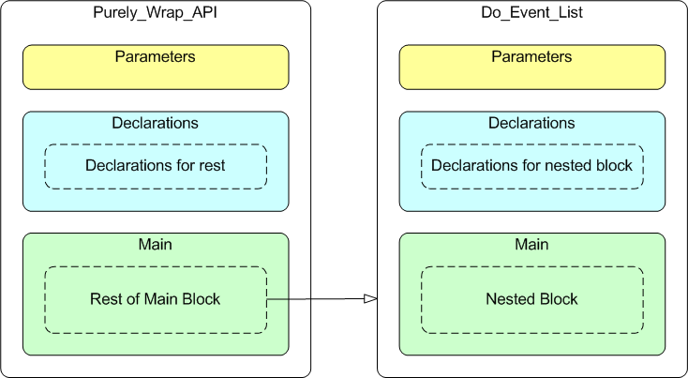
Refactoring Example - Purely_Wrap_API - After
Unit Test Automation
This refactoring from idea to publishing to GitHub took 1 hour:
Last Fri, 0630-0730
Possible because…
Unit Testing (see over)
Subprogram is split into two units each about half size of original
Do_Event_Lis takes all inputs as parameters and direct outputs as a return value
Also writes to database by nature of unit under test
These writes are read from caller, turned into direct output elements in the return array
Writes are then reverted to make Purely_Wrap_API ‘externally pure’

Slide 29
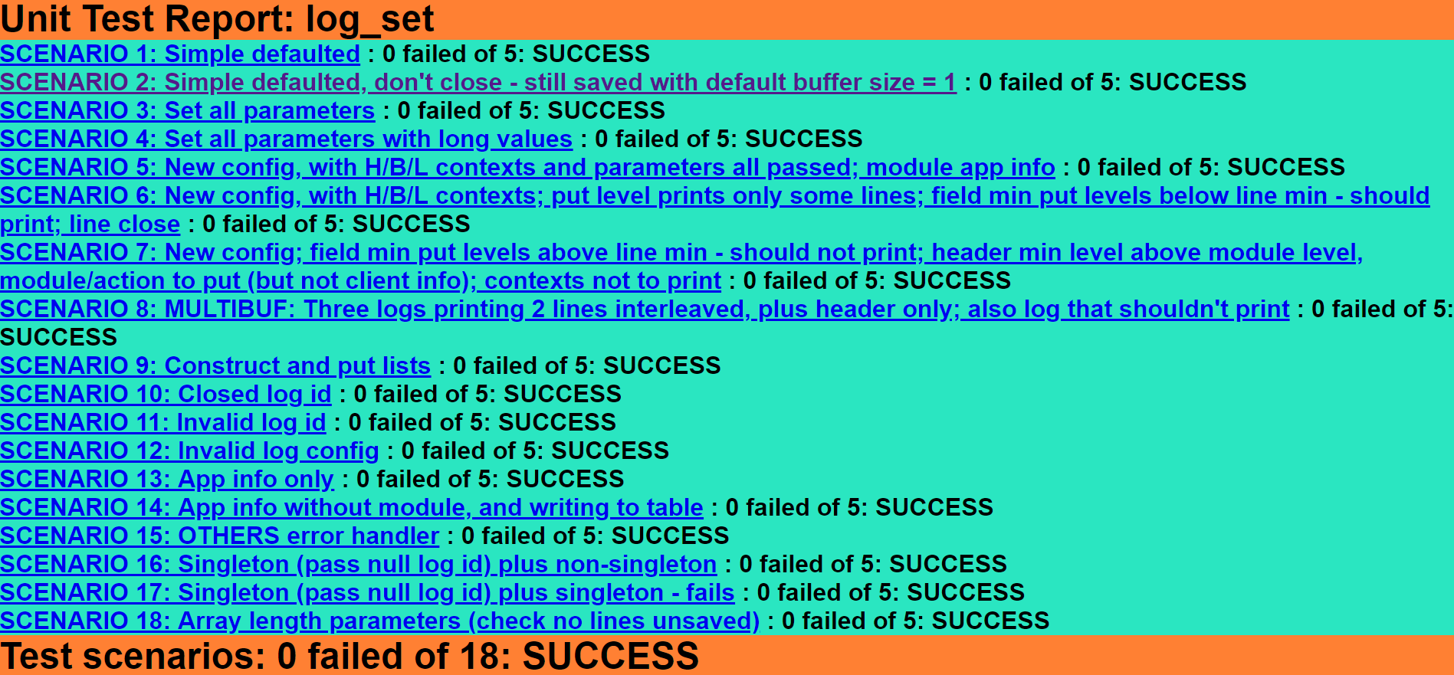
Clean Code, Refactoring and Unit Test Automation
Refactoring essential to writing clean code
Automated unit testing allows repeating tests in seconds, so can easily refactor many times
Tests must be at right level - behavioural/transactional - not Junit-style small code units

Slide 30
Oracle and Other Languages
Oracle and Other Languages
Concerning the integration of PL/SQL programs with other languages

Slide 31
Integration of PL/SQL with Other Languages: MLE and JSON
We have emphasized use of good design principles for clean coding in PL/SQL, inspired by:
Programming design concepts in general
Functional Programming, in particular
Some functionality may just be better done in other languages though…
For example, the HTML Unit Test summary links page on last slide was created in Javascript
Oracle Database Multilingual Engine may offer a future solution for direct integration…
“MLE is an experimental feature for the Oracle Database 12c. MLE enables developers to work efficiently with DB-resident data in modern programming languages and development environments of their choice."
Integration via JSON file exchange (see JSON Developer's Guide)
From Oracle 12.2 we can easily use JSON features to write output files in JSON format…
…then process the files in another language such as Javascript
This is how the unit testing of the Log Set package works
Next slide shows the structure of the input and output from Purely_Wrap_API
This is converted to a JSON file with expected and actuals included on the output side
Notes:
https://www.oracle.com/technetwork/database/multilingual-engine/overview/index.html
https://docs.oracle.com/en/database/oracle/oracle-database/18/adjsn/index.html

Slide 32
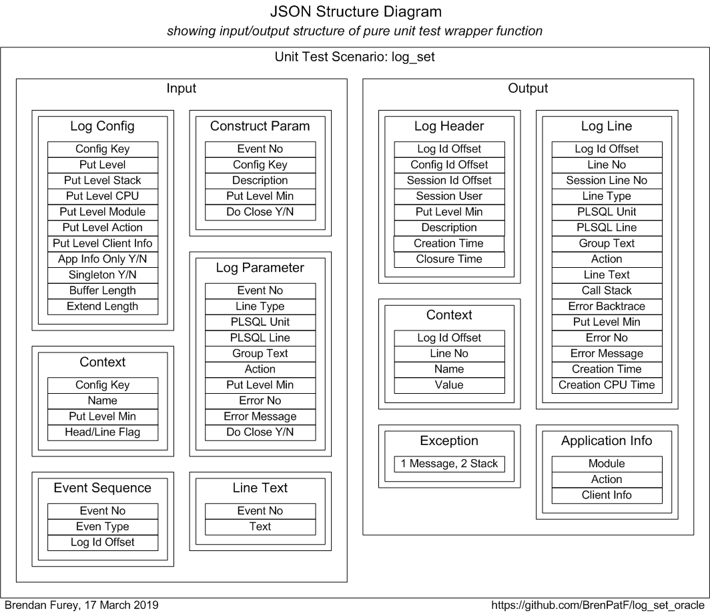
Integration of PL/SQL with Other Languages: Example JSON Diagram
Notes:
https://www.oracle.com/technetwork/database/multilingual-engine/overview/index.html
https://docs.oracle.com/en/database/oracle/oracle-database/18/adjsn/index.html

Slide 33
Oracle's Object Orientation
Oracle's Object Orientation
Discussing appropriate use of Oracle’s object-oriented features

Slide 34
Objects in Tables
Columns Based on non-Collection Object Types
Object (or record) types may be used for grouping fields in PL/SQL, as mentioned earlier
On the database, however, the table would be the natural way to group fields
Columns Based on Collection Types
Generally master-detail relationships represented by two tables with foreign key link
This allows full use of database features such as field indexing, and simple delete and update of detail records
In exceptional cases, it may be considered acceptable to use a collection type column instead
Where the detail entity is considered to be contained within the master entity and…
…the detail collection is always accessed as a whole
Nested array could then be considered natural physical model from logical
For example, the Log Set logging framework treats system contexts in this way as detail collections within header and line tables
Log lines though are modelled as a conventional table linked to headers

Slide 35
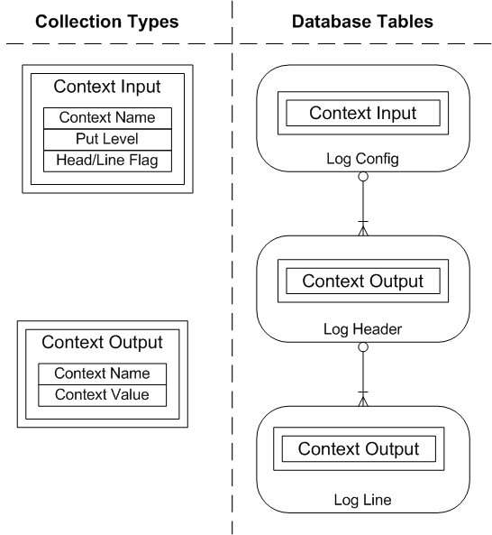
Log Set Data Model with Nested Object Types
Two collection types defined on database
Used as column types in tables as shown

Slide 36
Oracle's Object Orientation - Programming Issues
Oracle has had object oriented programming capabilities since around 1997
Very rarely used, while some PL/SQL new techniques become widespread quickly. Eg…
Analytic functions introduced same time, now widespread
Subquery factors introduced in v9, now widespread
Why is this? I suggest three main reasons:
1. PL/SQL as a Persistence Layer for the Database
Recall one definition of OO paradigm:
Send messages between objects to simulate the temporal evolution of a set of real world phenomena
Getting and setting data from/to the database is different from writing computer games
2. Deficiencies in Oracle’s OO Implementation
Oracle’s types for use in PL/SQL are defined at schema level and lack…
Private instance attributes (bad from Information Hiding perspective)
Instance level Index By arrays (important programming construct in any language)
3. Packages are Good Enough
Type inheritance, as we noted, not recommended, and other features available in packages …
Notes:
http://people.cs.aau.dk/~normark/prog3-03/html/notes/paradigms_themes-paradigm-overview-section.html#paradigms_oo-paradigm-overview_title_1

Slide 37
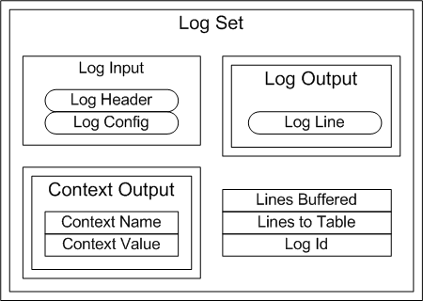
Programming Object Instance in PL/SQL
Sometimes we need to model objects having state, eg in instrumentation code such as Log Set
Suggestion: Do not use object type bodies, but packages, records and arrays instead
1. Define record with the structure required for the state
2. Define an array of records to maintain the states independently
3. Use the array index as the object handle, passing it as a parameter to methods
4. Place code in a single package to represent the object, with object array at package body level
TYPE log_inp_rec IS RECORD(
header log_headers%ROWTYPE,
config_rec log_configs%ROWTYPE
);
TYPE log_out_arr IS VARRAY(32767) OF
log_lines%ROWTYPE;
TYPE log_rec IS RECORD(
inps log_inp_rec,
ctx_out_lis ctx_out_arr,
out_lis log_out_arr,
lines_buf PLS_INTEGER,
lines_tab PLS_INTEGER,
log_id PLS_INTEGER
);
TYPE log_arr IS TABLE OF log_rec
INDEX BY BINARY_INTEGER;
g_log_lis log_arr;

Slide 38
SQL and Modularity
SQL and Modularity
Discussing application of modular design concepts in relation to SQL

Slide 39

Centralizing SQL in Views and Functions
Views and database functions can be used to centralize SQL
Can then use them in multiple places
However, using them as building blocks in larger queries can lead to problems…
…coupling between the calling programs and complex underlying SQL
DRY can conflict with other design principles, and sometimes…
…repeating simple declarative code such as SQL joins may be preferable
SQL and Modularity: Patterns, Anti-Patterns and the Kitchen Sink
Notes:
http://aprogrammerwrites.eu/?p=931

Slide 40
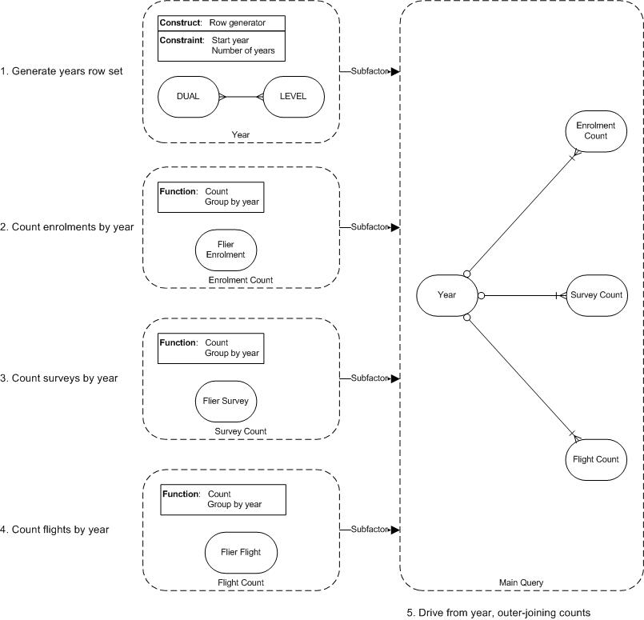
Modular SQL via Subquery Factors
Use subquery factors to modularize, diagrams can help…
Query Structure Diagramming
Notes:
http://aprogrammerwrites.eu/?p=206

Slide 41
Extracting Pure Functionality from SQL Queries
We can use the idea of separating out pure functionality into modules in SQL also
Here is an example where the WITH FUNCTION clause is used to do that…
Extracting Pure Functionality from SQL Queries
WITH FUNCTION calc_bonus(p_jhs_emp_id NUMBER, p_job_id VARCHAR2, p_salary NUMBER, p_avgsal NUMBER) RETURN NUMBER IS
BEGIN
RETURN Round(0.1 *
Nvl(p_avgsal, p_salary) *
CASE WHEN p_jhs_emp_id IS NULL THEN 1 ELSE 1.1 END *
CASE p_job_id WHEN 'IT_PROG' THEN 1.5 ELSE 1 END);
END;
depsals AS (
SELECT dep.department_id, dep.manager_id, Avg(emp.salary) avgsal
FROM departments dep
JOIN employees emp ON emp.department_id = dep.department_id
GROUP BY Dep.department_id, dep.manager_id
)
SELECT emp.employee_id, emp.salary, dsl.avgsal,
calc_bonus(jhs.employee_id, job.job_id, emp.salary, dsl.avgsal) bonus
FROM employees emp
JOIN jobs job
ON emp.job_id = job.job_id
LEFT JOIN depsals dsl
ON dsl.manager_id = emp.employee_id
LEFT JOIN (SELECT employee_id FROM job_history GROUP BY employee_id) jhs
ON jhs.employee_id = emp.employee_id
ORDER BY 1
Notes:
http://aprogrammerwrites.eu/?p=2539

Slide 42
Conclusion
Conclusion
Recommendations around Oracle program design

Slide 43
Conclusion
Create small, cohesive subprograms, separating pure functionality from database accessors
Subprograms should return 0 or 1 (possibly complex) values
Avoid package state, except where necessary, and use a flat, non-nested subprogram structure
Group simple, uncoupled subprograms into moderately sized packages of related types
Use a single package each for complex code serving a single purpose
Provide clean API interfaces using record types, defaults and overloading
Use generic types and collections where this reduces duplication
Facilitate refactoring with automated unit tests at a transactional level
Consider integrating other languages for complex non-database processing, possibly via JSON
Use Oracle's object types freely, but avoid inheritance and type bodies
Follow a simple array-based design pattern, where object state instances are required
Use subquery factors extensively to modularize SQL queries
Use views where appropriate, but try to avoid coupling problems from joining complex views
Use functions in the WITH clause to separate out pure functionality where possible

Slide 44
References
Modularity
OCR Computing A-Level Revision
Overview of programming paradigms
Two main approaches to programming
Main programming paradigms
Overview of the four main programming paradigms
DRY: Don't repeat yourself
Coupling versus cohesion
Functional design
information hiding (Vangie Beal in Webopeida)
Nesting in Ada Programs is for the Birds (Clarke, Wileden & Wolf, 1980)
On Inheritance (in Goodbye, Object Oriented Programming (Scalfani, 2016)
JavaScript Inheritance vs Composition (Tyler McGinnis, 2019)
Collection Types (Oracle Database PL/SQL Language Reference, v12.1)
Log_Set (My Oracle logging framework on GitHub)
Oracle Database Multilingual Engine
JSON Developer's Guide
SQL and Modularity: Patterns, Anti-Patterns and the Kitchen Sink
Query Structure Diagramming
Extracting Pure Functionality from SQL Queries

